Slide 1
Comprehensive Capital Calculation using Stochastic Dominance Approach
Final Project By:
Manali Singhal Naveena Elamaran Sneha chemerla
Pankaj NEGI Prateek Bhatnagar

Slide 2
Introduction
The Basel III Accord requires that banks and other Financial Institutions communicate their daily risk forecasts to the appropriate monetary authorities at the beginning of each trading day.
The risk estimates from these models are used to determine the daily capital charges (DCC) and associated capital costs of Financial Institutions.

Slide 3
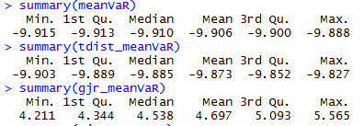
VaR and DCC
Value at Risk measures the potential loss in value of a risky asset or portfolio over a defined period for a given confidence interval.
Daily Capital Charges are the capital requirements to be maintained by the financial institutions to meet the Basel III requirements, and this is calculated from various VaR models at the beginning of the trading day.

Slide 4
Data - VIX Futures
30-day maturity CBOE VIX volatility index futures (ticker name VX).
Key measure of market expectations of near-term volatility conveyed by S&P 500 stock index option prices
Characteristics:
Non-Stationary
Time varying volatility
No clear trend
Liquid

Slide 5
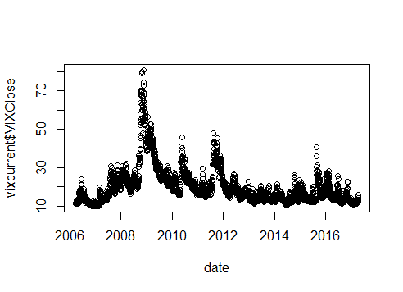
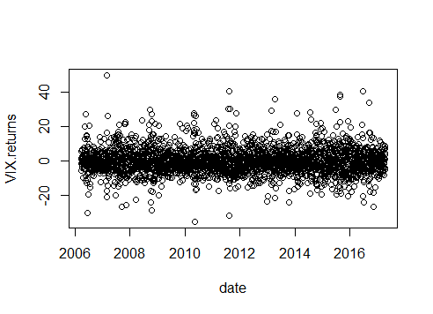
Data – VIX Futures

Slide 6
Forecasting VaR models
Conditional volatility models used to determine VaR:
GARCH
GJR – GARCH
Distributions used:
Gaussian distribution
Student-t distribution

Slide 7
GARCH Model
A natural generalization of ARCH (GARCH):
a_{t} = σ_{t}ε_{t}
σ²_{t} = α₀ + Σ^{p}_{i=1}α_{i}a²_{t−i} + Σ^{q}_{j=1} β_{j}σ²_{t−j} ,
where ε_{t} is identically and independently distributed with mean 0, standard deviation 1 and independent of a_{t−1}... Also α > 0, α_{i} and β_{j} ≥ 0, and Σ^{p}_{i=1}α_{i} + Σ^{q}_{j=1} β_{j} < 1.
This model manages to model the volatility clustering and the mean reverting characteristics.

Slide 8
GARCH Model - Code
GARCH – Gaussian Distribution
VaR5n=NULL
logret=VIX.returns
for (i in 1:59)
{
model=garchFit(~garch(1,1),data=logret,trace=F,cond.dist='norm')
model
x=as.data.frame(predict(model,5));
x
VaR5n =append(VaR5n,x$meanForecast[1]- qnorm(1-0.05)*(x$meanError[1]))
VaR5n
logret=logret[-1]
}
VaR5n
meanVaR=NULL
for (i in 1:59)
{
meanVaR=append(meanVaR,mean(VaR5n[1:i]))
}
meanVaR
summary(meanVaR)
Gaussian_DCC=NULL
for (i in 1:59)
{
Gaussian_DCC=append(Gaussian_DCC,min(meanVaR[i],VaR5n[i]))
}
Gaussian_DCC
norm_Gaussian_DCC=normalized(Gaussian_DCC)

Slide 9
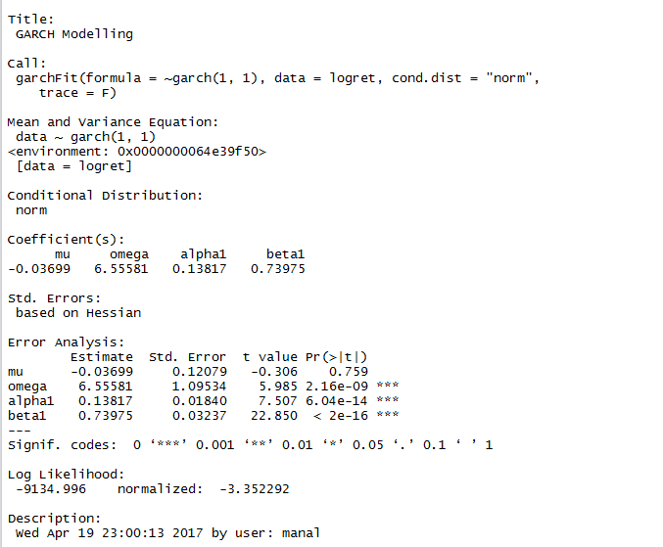
GARCH Model - Result

Slide 10
GJR-GARCH Model
The conditional variance now given by
ℎ_{𝑡}² =∝₀+ Σ^{p}_{i=1} (α_{i}𝑍_{𝑡−𝑖} ² (1 − 𝐼[𝑍_{𝑡−𝑖} > 0]) + 𝛾_{𝑖}𝑍_{𝑡−𝑖} ² 𝐼[𝑍_{𝑡−𝑖} > 0]) + Σ^{q}_{i=1}𝛽_{𝑗}ℎ_{𝑡−𝑗}²
where ∝₀> 0, ∝_{𝑖}≥ 0, 𝛽_{𝑗} ≥ 0 and 𝛾_{𝑖} ≥ 0 to guarantee that the conditional variance is nonnegative. capture the asymmetric effect of positive and negative shocks
This model captures the asymmetric effect of positive and negative shocks

Slide 11
GJR-GARCH Model - Code
GJR-GARCH – Gaussian Distribution
gjr_logret=VIX.returns
spec.gjrGARCH = ugarchspec(variance.model=list(model="gjrGARCH", garchOrder=c(1,1)), mean.model=list(armaOrder=c(1,1), include.mean=TRUE), distribution.model="norm")
gjrGARCH <- ugarchfit(gjr_logret, spec=spec.gjrGARCH)
gjrGARCH
spec2=spec.gjrGARCH
setfixed(spec2)=as.list(coef(gjrGARCH))
filt=ugarchfilter(spec2,gjr_logret)
gjr_VaR=fitted(filt)+sigma(filt)+qdist("norm",p=0.05,mu=0,sigma=1,skew=coef(gjrGARCH)["skew"],shape=coef(gjrGARCH)["shape"])
gjr_VaR[(length(gjr_VaR) -60):length(gjr_VaR)]
gjr_meanVaR=NULL
for (i in 1:59)
{
gjr_meanVaR=append(gjr_meanVaR,mean(gjr_VaR[1:i]))
}
gjr_meanVaR
summary(gjr_meanVaR)
gjrGaussian_DCC=NULL
for (i in 1:59)
{
gjrGaussian_DCC=append(gjrGaussian_DCC,min(gjr_meanVaR[i],gjr_VaR[i]))
}
gjrGaussian_DCC
norm_gjrGaussian_DCC=normalized(gjrGaussian_DCC)

Slide 12
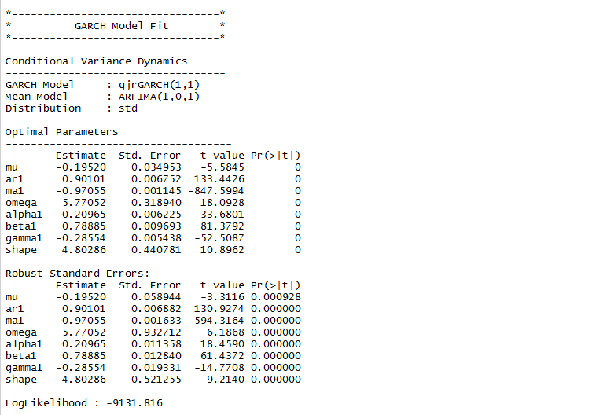
GJR- GARCH Model - Result

Slide 13
Stochastic Dominance
The decision rule would be as follows:
Null Hypothesis | Decision Rule | Inference | Decision of a risk manager
H₀: Y FSD X | If H₀ not rejected, Y dominates X | DCC of Model 1 is likely to be higher than of Model 2 | Risk manager prefers Model 2 to Model 1

Slide 14
DCC Evaluation
The primary objective is to evaluate each of the alternative conditional volatility models with respect to the DCC function.
Each model will give different values of DCC by producing different VaR forecasts.
The stochastic dominance concept is applied in this context to determine which model should be used for producing a lower DCC for a given amount invested.

Slide 15
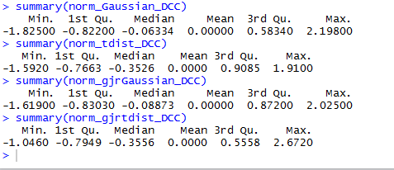
DCC Evaluation

Slide 16
Results
Forecasted VaR using GARCH and GJR-GARCH
Calculated Daily Capital Charges from the forecasted VaR
Performed pair-wise comparison for a variety of models
Plotted CDFs for the models using with Gaussian and Student t-distribution

Slide 17
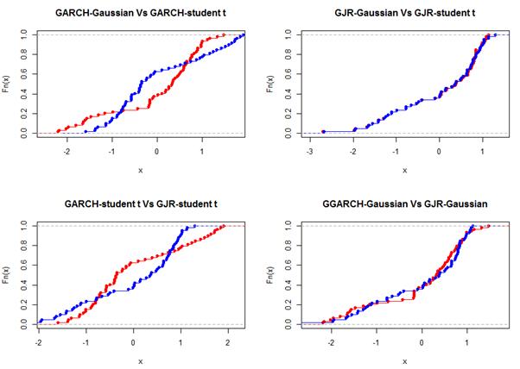
Results

Slide 18
Future Prospects
VaR can be predicted using other models such as EGARCH.
We can test for second-order stochastic dominance (SSD) in order to account for risk aversion.

Slide 19
Conclusion
On plotting the CDFs, we found that they cross, and hence first order stochastic dominance cannot be established. However, high crossing point SSD is likely.
Based on the difference in ICDF plots, the SSD can be established and the dominated model will be preferred by a risk averse manager.

Slide 20
Thank You

